Slide 1

Senior Design Project Presentation on WIRELESS POWER TRANSFER FOR CHARGING OF ELECTRIC VEHICLES
Presented by
Ms. SHUBHANI ARUNASHREE
Reg No:1941016019
Mr. SNEHASHIS SUBUDHI RATNA
Reg No:1941016051
Supervisor
Prof. SABITA MALI
Department of Electronics & Communication Engineering
Institute of Technical Education & Research (FET)
Siksha ‘O’ Anusandhan Deemed to be University, Bhubaneswar
June, 2023

Slide 2
Contents
Introduction
Literature Survey
Design Scheme
Testing, Analysis, And Evaluation
Socio-economic Issues Associated With The Project
Engineering Tools And Standards
Conclusion

Slide 3
Introduction
Eco-friendly vehicle is the global trend in the automobile industry. It is the most suitable alternative of petroleum vehicles.
Electric Vehicles charging process and travelling range has become a major issue which is affecting it’s adoption over petrol or diesel vehicles.
To solve these problems, wireless charging of electric vehicle is introduced.
It reduces the time spent on recharging or even allows the EV to get charged during its movement.
The daily travel expenses of individuals can be less with using electric vehicles.

Slide 4
Literature Survey
Sl No. | Author | Techniques | Description
1. | Taylor M.Fisher, Yabiao Gao [1] | Wireless Power Transfer | Wireless charging (WC) technology operates on the principles of magnetic inductance and magnetic resonance. A magnetic field is induced in the surrounding area by running currents through a coil of wire. Exposing another coil nearby to that magnetic field will induce an electric current in the nearby coil; thus, wireless power transfer (WPT) is achieved.
2. | Muhammad Amzad,Farooq-i-Azam [2] | Types of EV Wireless Charging Technology | Static charging is a stationary wireless charging method, where the vehicle charges under standstill conditions. In Dynamic charging method, a stationary transmitter transmits power over the air to the receiver coil in a moving vehicle.

Slide 5
Literature Survey
Sl No. | Author | Techniques | Description
3. | Yong Li, Jiefeng Hu [3] | Types of Dynamic charging for EV | Wireless Capacitive Electric Vehicle Charging System. Permanent Magnetic Gear Wireless Electric Vehicle Charging System. The Inductive Wireless Electric Vehicle Charging System. Resonant induction Electric Vehicle Charging System.
4. | Alhamroun,Ibrahim [4] | Inductive wireless charging | The basic principle of inductive wireless charging(IWC) is Faraday's law of induction. The wireless transmission of power is achieved by mutual induction of magnetic field between transmitter and receiver coil.

Slide 6
Literature Survey
Sl No. | Author | Techniques | Description
5. | Musavi, Fariborz, Murray Edington [5] | Working principle used for power transfer | When the main AC supply applied to the transmitter coil, it creates AC magnetic field that passes through receiver coil and this magnetic field moves electrons in receiver coil causes AC power output. This AC output is rectified and filtered to Charge the EV’s energy storage system. The amount of power transferred depends on frequency, mutual inductance and distance between transmitter and receiver coil. Operating frequency of inductive wireless charging is between 19 to 50 KHz [6].

Slide 7
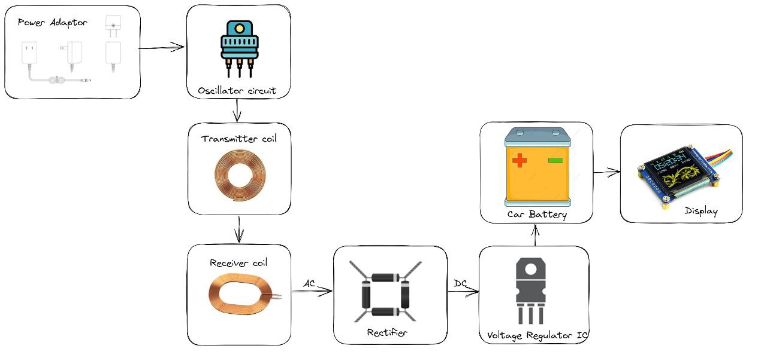
Design Scheme
Block diagram of a wireless power transfer for electric vehicles

Slide 8
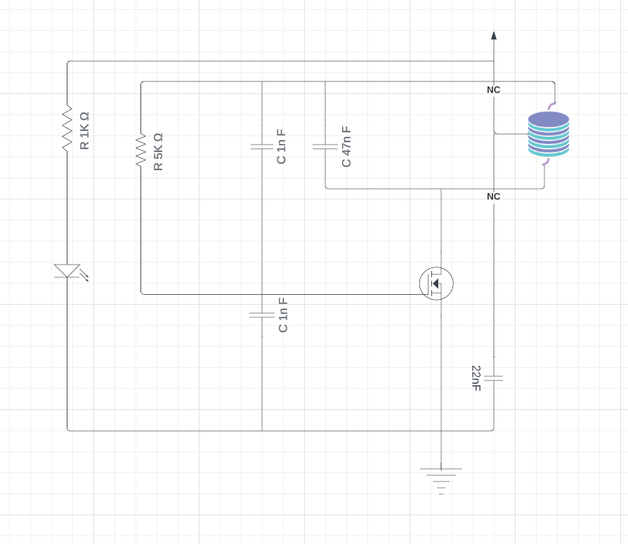
Circuit Diagram : Transmitter
10 Turn
20 AWG
IRFZ44N
Transmitter Part of a wireless power transfer for electric vehicles

Slide 9
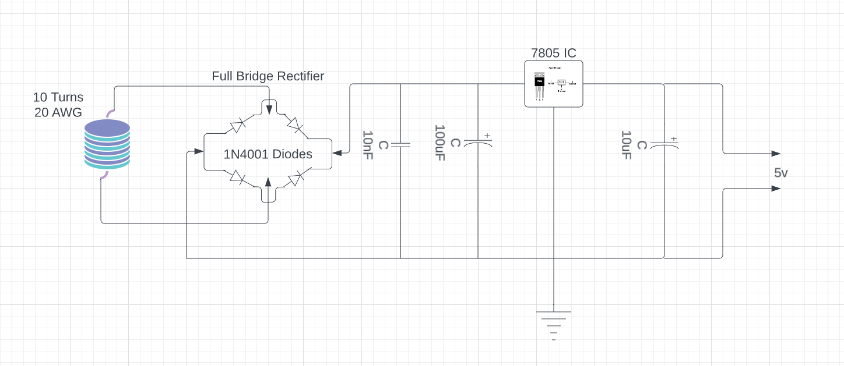
Circuit Diagram : Receiver
Receiver Part of a wireless power transfer for electric vehicles

Slide 10
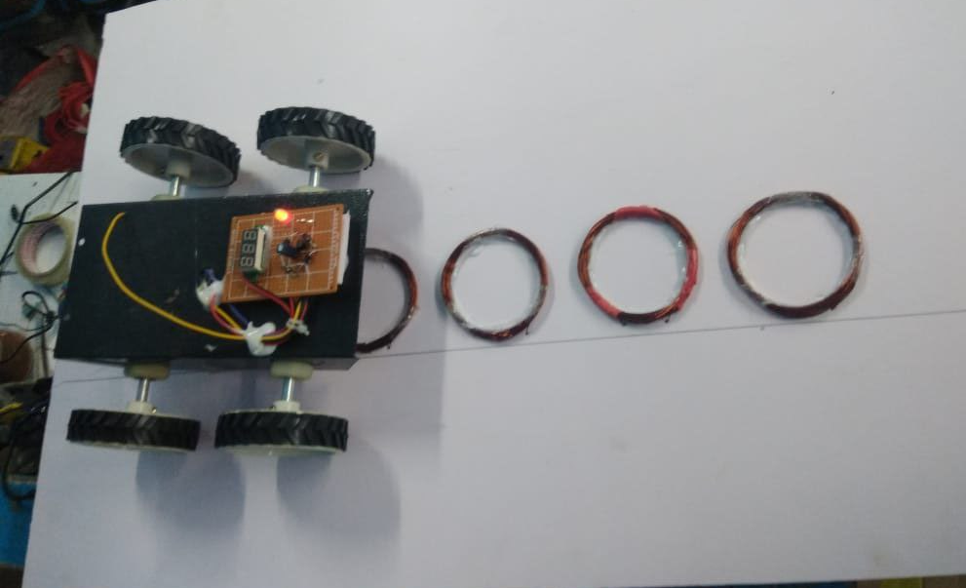
Testing

Slide 11
Results, Analysis and Evaluation

Slide 12
Socio-economic Issues Associated With The Project
Initial installation cost is very high.
Working area is limited.
Heat generation is more than traditional charging.
Copper loss because a large amount of copper wire is required for implementation of Wireless Power Transfer.

Slide 13
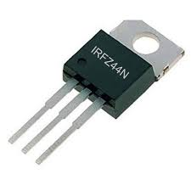
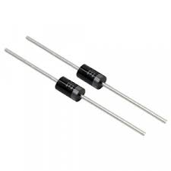
Engineering Tools And Standards
IRFZ44N :
The IRFZ44N is a N-channel MOSFET. Its features include very low on state resistance, high speed processing technology, completely avalanche rated etc. The transistor possesses high speed switching capability which makes it ideal to use in applications where high speed switching is a crucial requirement.
The IRFZ44N is known for its high drain current and fast switching speed. Adding to that it also has a low Rds value which will help in increasing the efficiency of switching circuits.
IRFZ44N :
1N4001 Diodes :
The 1N4001-T is a Rectifier Diode with moulded plastic case. The rectifier diode has high current capability and low forward voltage drop.
Used for rectification in battery chargers, power supply circuits, and other electronics appliances. Used to block the current, block the voltage spikes, and boost the voltage, blocking unwanted incoming voltage, etc. Used in Voltage doublers. Used in adapter circuits.

Slide 14
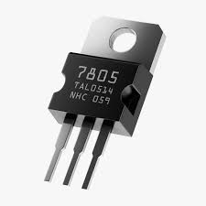
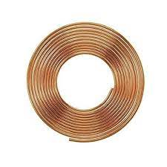
7805 IC :
The LM7805 is a voltage regulator that outputs +5 volts.
Voltage regulator 7805 IC is used for current regulators and fixed output regulators, and adjustable output voltage regulators.
Minimum Input voltage is 7V
Maximum Input Voltage is 35V
Current rating Ic = 1A
Maximum Output Voltage VMax=5.2V
Minimum Output Voltage VMin=4.8V
Copper Wires:
Copper wire is a popular choice for industrial and commercial electrical applications. It can be used for power transmission, communications and networking, electric motors, lighting, and heating.
Copper wire is used in a wide variety of applications, including: Wires for electric motors.

Slide 15
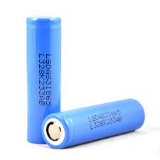
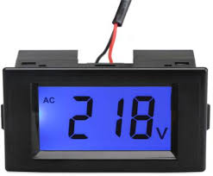
lithium-ion battery :
A lithium-ion battery is a type of rechargeable battery that is charged and discharged by lithium ions moving between the negative (anode) and positive (cathode) electrodes.
Voltage Digital sensor :
Sensors can have various Voltage outputs 5 volts, 10 volts -5 to +5 volts and more.
Sensors having a Voltage output are calibrated over this range against various engineering units such as so that the output value corresponds to a specific value of pressure, temperature, load, tilt etc.

Slide 16
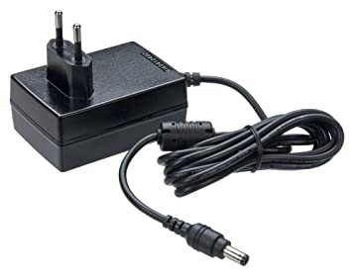
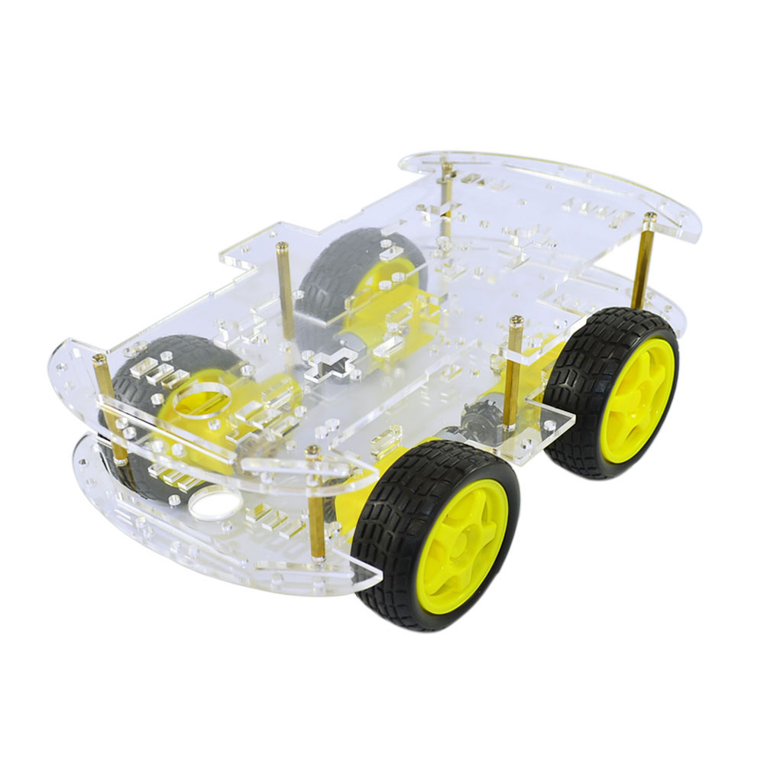
Power Adapter :
The power adapter serves the purpose of converting AC voltage to a single DC voltage for your computer.
Car Chesis :
The chassis of a vehicle is the load-bearing part of the frame, which in turn is the structural element of the body of the car

Slide 17
Conclusion
wireless power transfer (WPT) systems have emerged as a promising technology with numerous applications and benefits. Throughout this study, we have explored the key aspects and implications of WPT systems. Here are the main conclusions drawn from our analysis:
Efficiency and Convenience: Wireless power transfer offers the convenience of eliminating the need for physical connections between power sources and devices. This technology enables seamless charging of electronic devices.
Scalability and Flexibility: WPT systems can be designed to accommodate various power requirements, ranging from low-power applications to high-power applications.
Future Prospects: The future of wireless power transfer looks promising. As technology continues to evolve, we can expect further advancements in WPT efficiency, extended operating ranges, and integration into a broader range of applications. WPT has the potential to revolutionize various industries, including consumer electronics, transportation, healthcare, and infrastructure.

Slide 18
References
[1] Fisher, Taylor M, et al. "Electric vehicle wireless charging technology: a state-of-the-art review of magnetic coupling systems." Wireless Power Transfer (2014).
[2] Amjad, Muhammad, et al. "Wireless charging systems for electric vehicles.’’ Renewable and Sustainable Energy Reviews (2022)
[3] Li, Yong, et al. "A new coil structure and its optimization design with constant output voltage and constant output current for electric vehicle dynamic wireless charging." IEEE Transactions on Industrial Informatics (2019).
[4] Alhamrouni, Ibrahim, et al. "Application of inductive coupling for wireless power transfer." International Journal of Power Electronics and Drive Systems 11.3 (2020)
[5] Musavi, Fariborz, Murray Edington, and Wilson Eberle. "Wireless power transfer: A survey of EV battery charging technologies." 2012 IEEE Energy Conversion Congress and Exposition (ECCE). IEEE, 2012.
[6] Panchal, Chirag, Sascha Stegen, and Junwei Lu. "Review of static and dynamic wireless electric vehicle charging system." Engineering science and technology, an international journal 21.5 (2018)

Slide 19


Slide 20



